Slide 1


NORTHWIND SALES ANALYSIS
DAX Power BI Portfolio Project
By Dushyant Prajapati

Slide 2

INTRODUCTION / PROJECT OVERVIEW
Developer: Dushyant Prajapati
Objective: Built a dynamic Sales Analytics Report to monitor key performance indicators (KPIs), customer insights, and demand forecasting.
Data Modeling: Implemented a Star Schema with proper relationships between Fact_Orders and Dimension tables (Customers, Products, Employees).
Advanced DAX: Solved real-world business problems using complex functions like CALCULATE, TOPN, RELATED, and SUMMARIZE.
Outcome: Extracted actionable insights for optimized decision-making and reporting.

Slide 3

DATABASE OVERVIEW
Dimension Tables:
Fact Table:
Calendar
Categories
Customers
Employees
Products
Suppliers
Orders

Slide 4

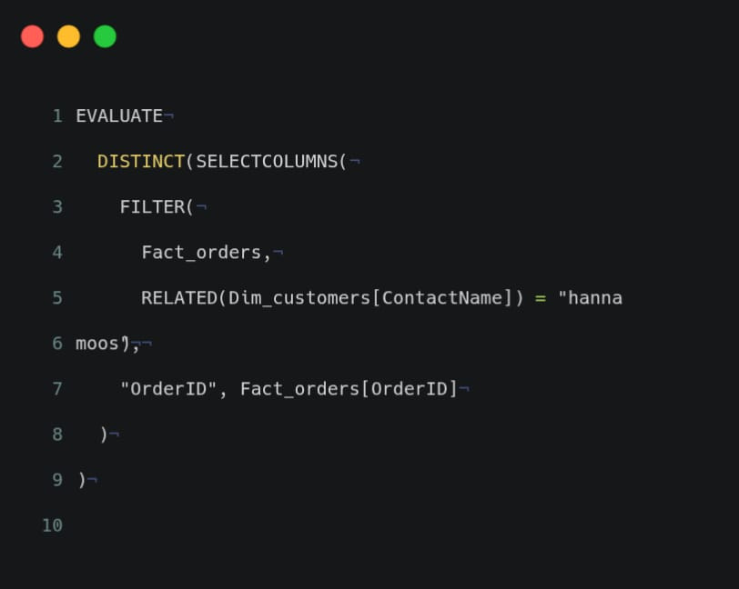
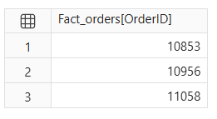
Business Question 1 : Customer Orders
Show all the orders of customer HANNA MOOS?

Slide 5
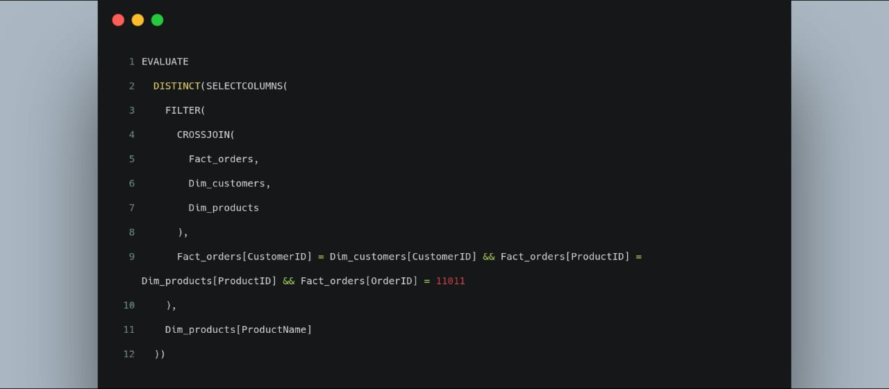


Business Question 2 : Products in Order 11011
Show all the products which purchase under 11011?

Slide 6

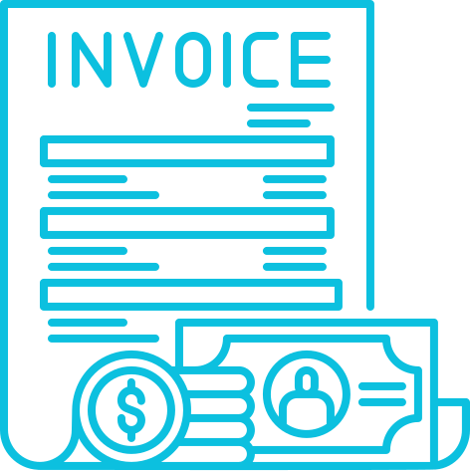

Business Question 3 : Order 11011 Total Amount
Show total amount of order 11011?
Total Amount
$960.00

Slide 7
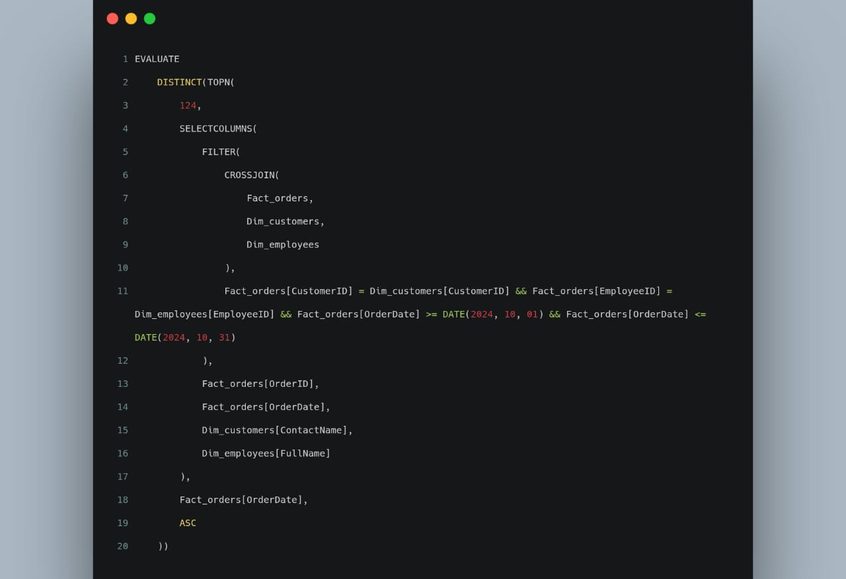

Business Question 4 : Orders Between Dates
Show all the orders between two date,include customername & employee name also?
View Query Output on Next Page
Click to Proceed to the results.

Slide 8
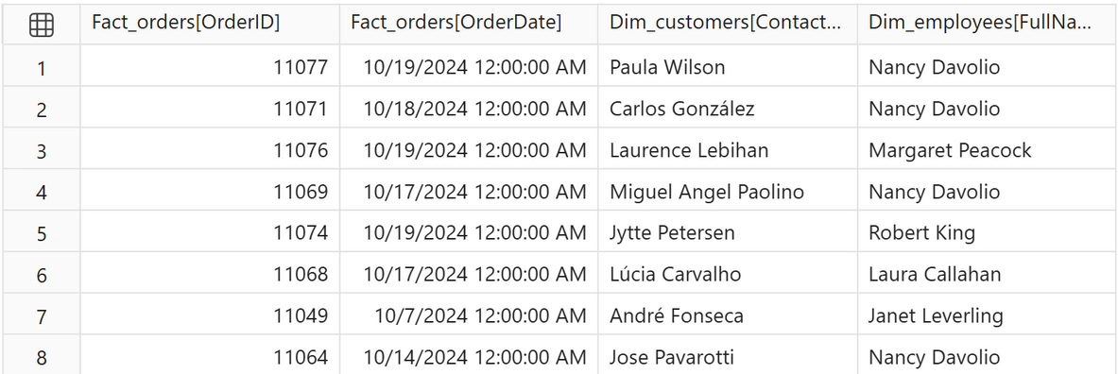
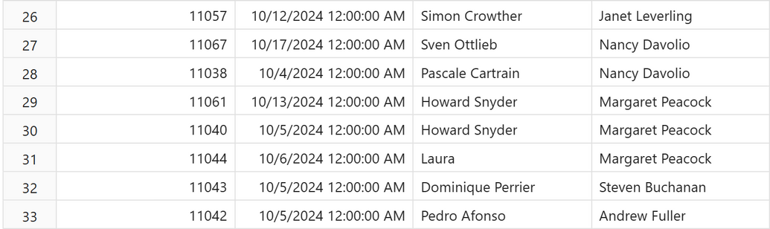
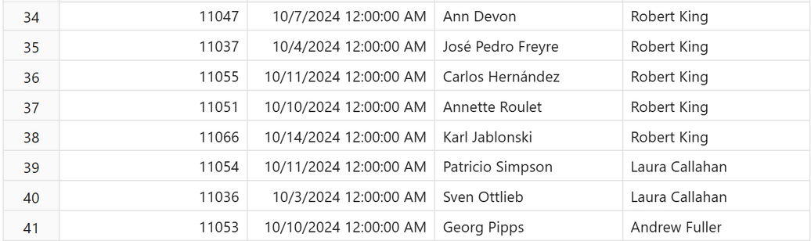
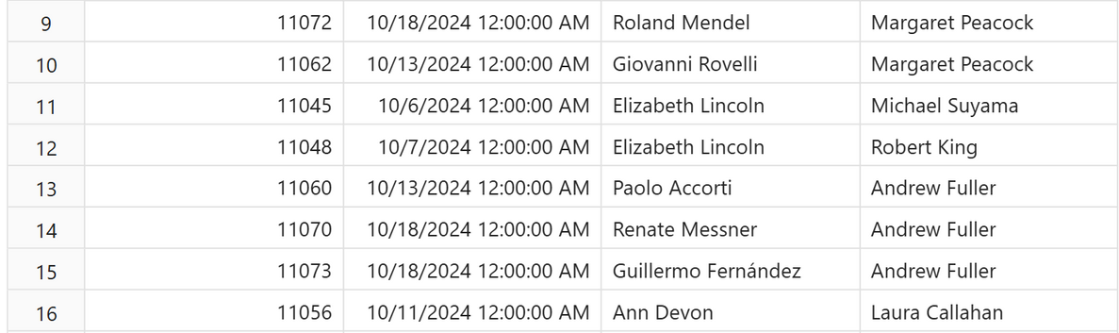

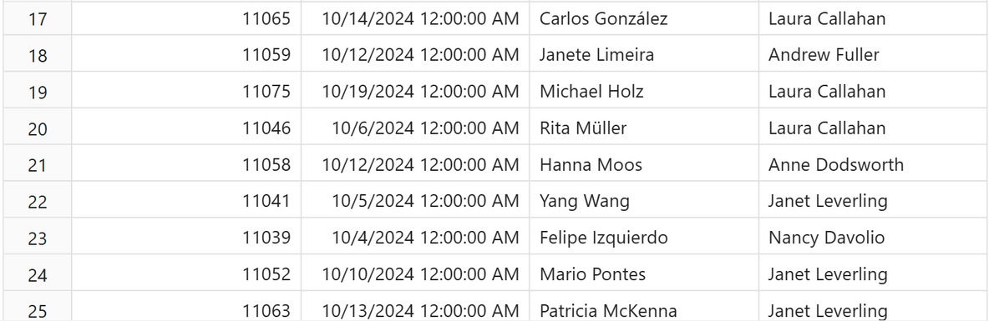
Show all the orders between two date,include customername & employee name also?

Slide 9

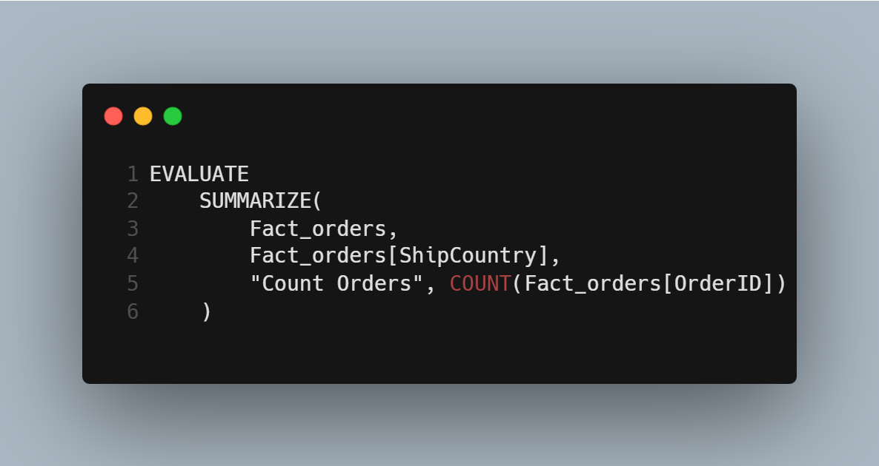
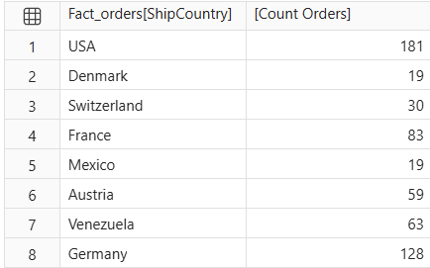
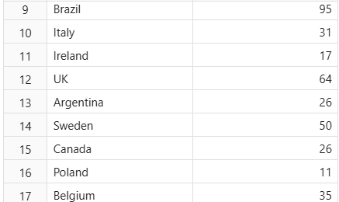
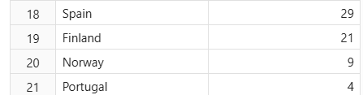
Business Question 5 : Each Country Orders
Count Orders of each country?

Slide 10
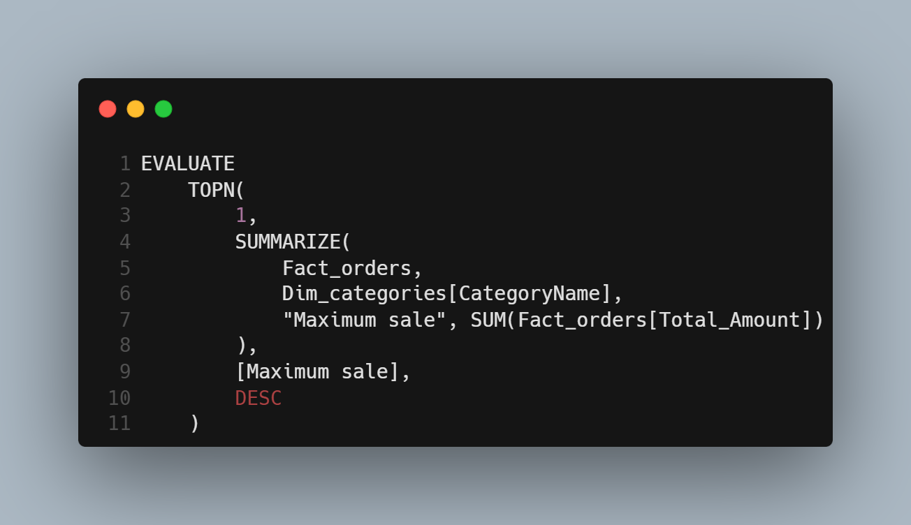

Business Question 6 : Sale Max Category
Max category sale in whole database?

Slide 11
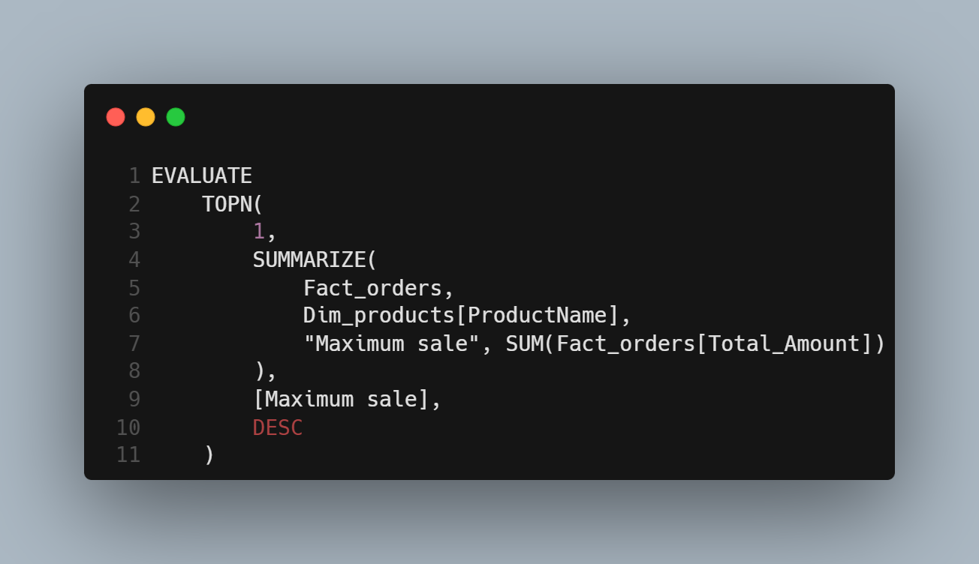


Business Question 7 : Sale Max Product
Max Product Sale in Whole Database?

Slide 12
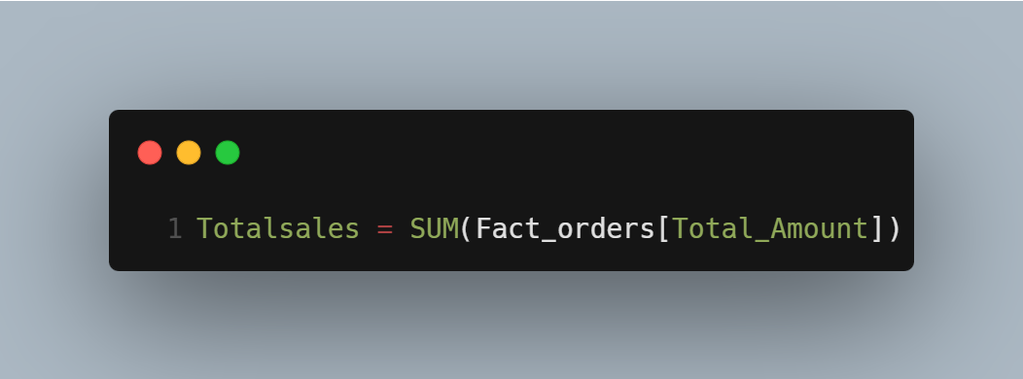

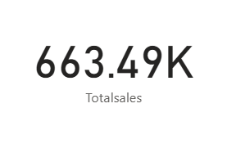
Business Question 8 : Total Sales
Total Sale in whole Database?

Slide 13
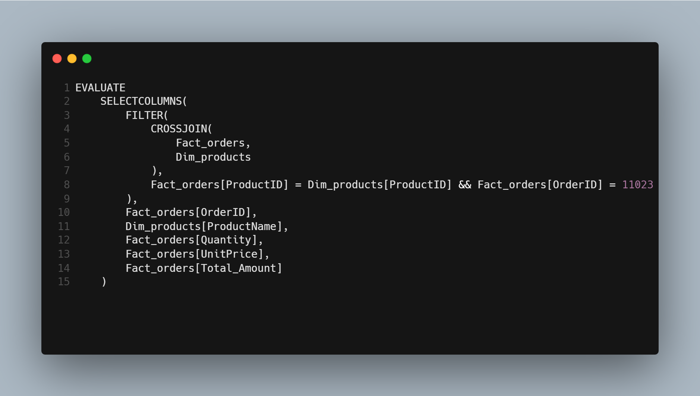

Business Question 9 : Particuler order
Show total amout of particuler order include productname,qtysale,price & total amount?

Slide 14

Business Question 10 : Laura Orders
Show all the orders made by Laura?
View Query Output on Next Page
Click to Proceed to the results.

Slide 15
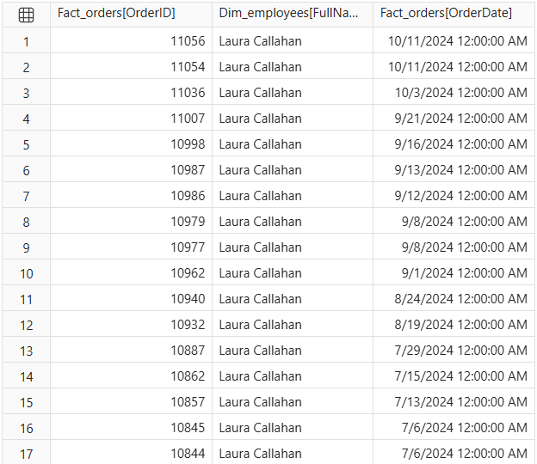
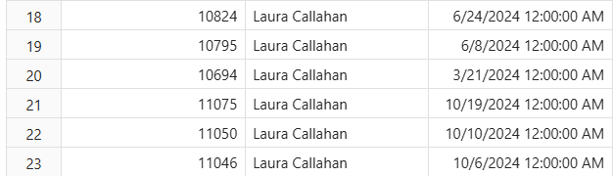
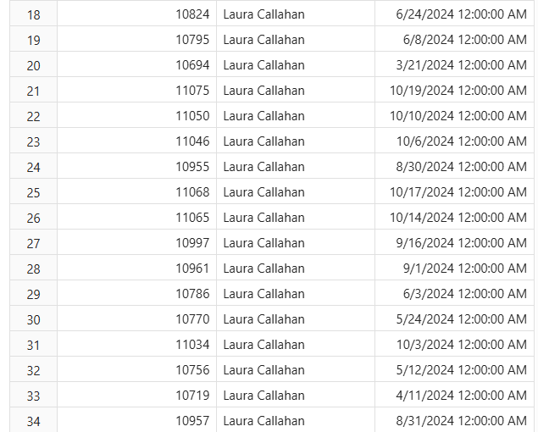
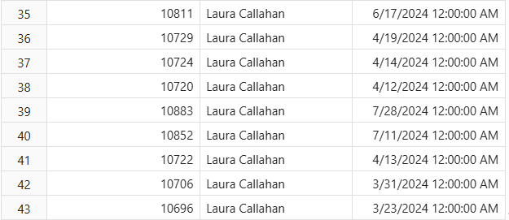
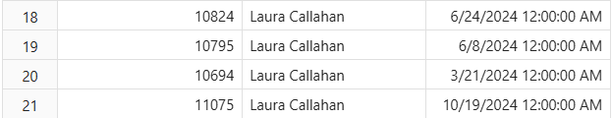
Show all the orders made by Laura?

Slide 16



Thank You!
For your time and attention.
dushyantprajapati2809@gmail.com
https://www.linkedin.com/in/dushyant-prajapati-a98a4a39a/
https://github.com/Analyst-Dushyant123
Designed & Developed by Dushyant Prajapati | 2026

